Slide 1


Exploratory Data Analysis on the Titanic Dataset
This presentation focuses on diving into the Titanic dataset to extract insights concerning passenger survival rates, demographics, and other factors using Python methodologies.

Slide 2


Introduction to Titanic Dataset
Dataset Overview
Columns Information
Objective of EDA
Includes vital attributes: Age, Sex, Pclass, and Survived status.
Comprises 12 columns with key details like ticket fare and embarkation port.
Uncover patterns for better understanding and predictions about survival.

Slide 3


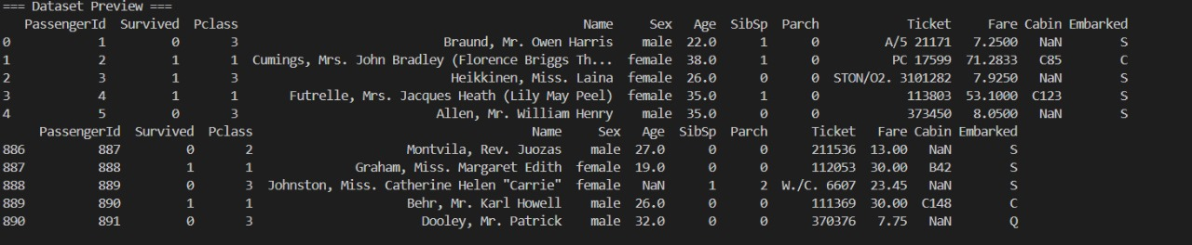
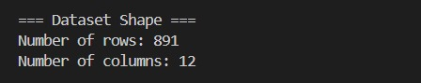
Importing Data
1
Pandas Library Utilization
Dataset Shape Examination
Initial Setup Importance
2
3
Data is imported using the pandas library, which provides versatile data manipulation and analysis capabilities in Python.
The shape of the dataset is examined to understand its structure, including the total number of rows (passengers) and columns (features).
This initial setup is crucial for planning subsequent analysis steps efficiently.

Slide 4




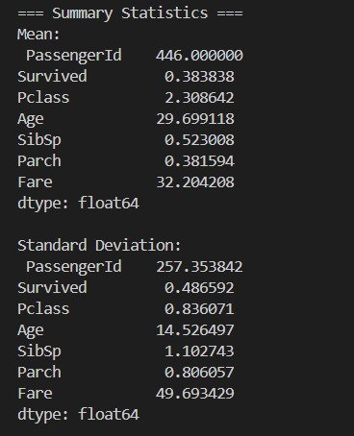
Viewing Data Types & Summary Statistics
Data Type Validation
Summary Statistics
Each column's data type is checked to ensure it aligns with expected formats.
Summary statistics such as mean, standard deviation, and quartiles are generated for numerical columns.
2
1
Foundation for Analysis
3
Understanding these metrics lays the groundwork for more detailed analysis and visualizations.

Slide 5



Data Preparation Steps
This section focuses on preparing data by eliminating irrelevant information, identifying missing values, and determining appropriate handling methods to enhance data quality before further analysis.
1
2
3
Drop Unnecessary Columns
Identify Missing Values
Handle Missing Data
Locate missing values in Age and Embarked columns for analysis.
Decide on imputation or dropping methods for missing data.
Remove columns like PassengerId and Ticket to focus on relevant data.

Slide 6
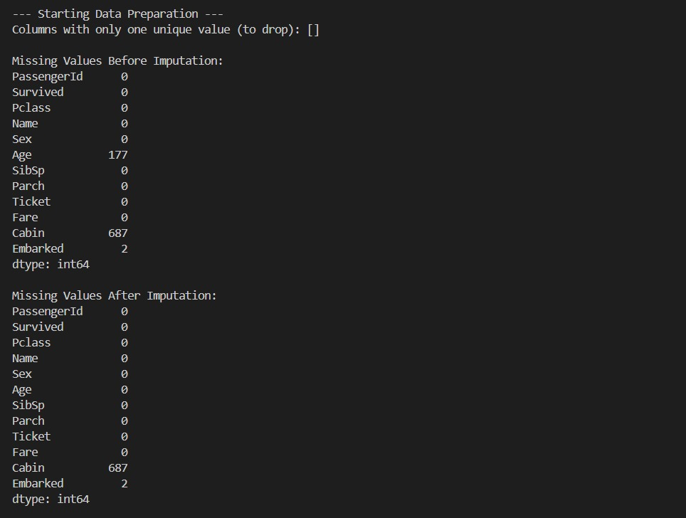
Drop Unnecessary Columns
Handle Missing Data

Slide 7





Data Visualization Techniques
Gender Distribution
Bar Graph of Survivors
Gender distribution is explored through a pie chart or horizontal bar plot to visualize the differences in survival rates between males and females.
A bar graph showcasing the count of survivors versus non-survivors offers a clear visual summary of survival outcomes.
1
2
Passenger Class Influence
Age Distribution Histogram
A stacked bar graph displays the relationship between passenger class (Pclass) and survival, highlighting how socio-economic status influenced outcomes.
4
3
The age distribution is presented using a histogram, revealing trends regarding age-related survival chances.

Slide 8
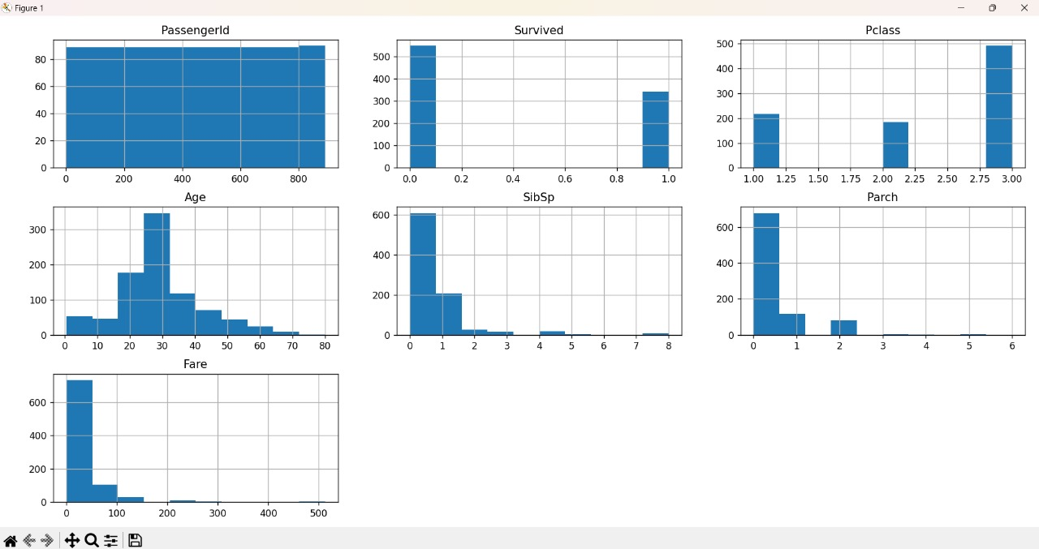
distribution is explored through a horizontal bar plot to visualize
Histogram Overview of Key Features

Slide 9




Conclusion of Exploratory Data Analysis
Significant Findings
Future Steps
Research Insights
Survival rates are higher for females and first-class passengers.
Building predictive models based on identified patterns.
Insights can guide new analyses on passenger dynamics.

